Slide 1

COMPREHENSIVE DIGITAL MARKETING
PROJECT DONE BY :
SAI SAMHITHA PATNAYAKUNI
This

Slide 2
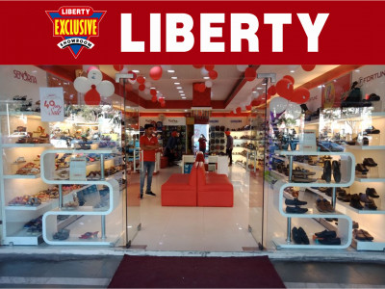
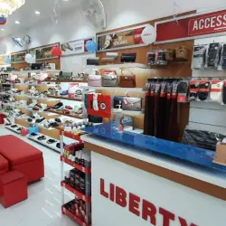

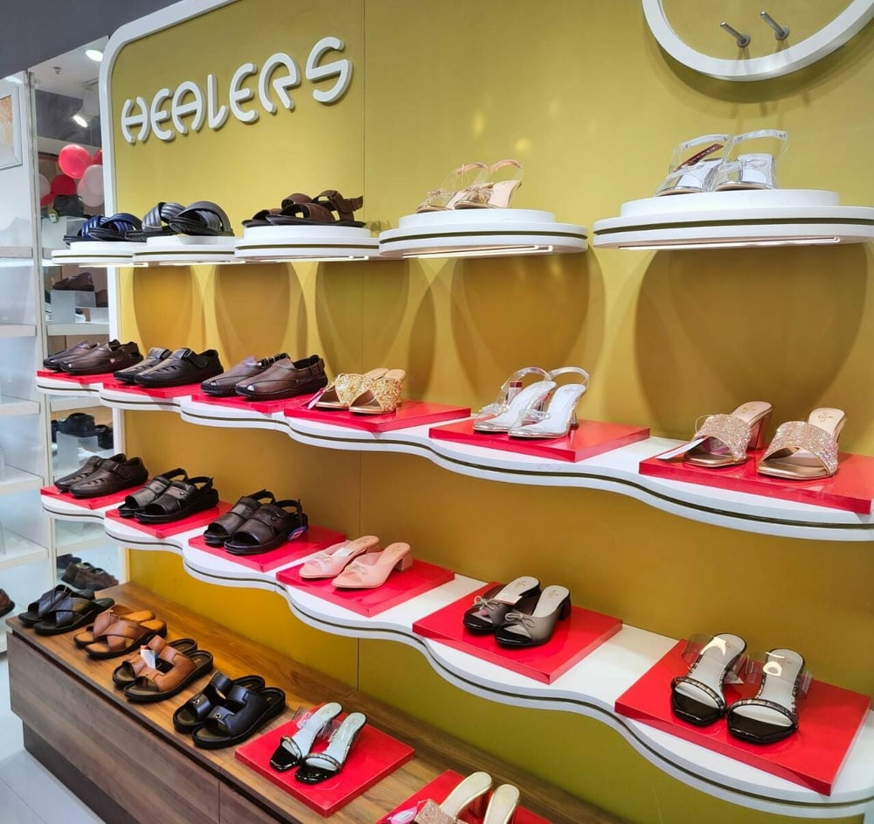
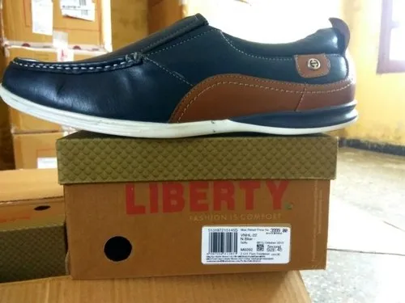

Slide 3

Part 1: Brand study, Competitor Analysis & Buyer’s/Audience’s Persona
COMPANY/TOPIC for project: LIBERTY
Research Brand Identity:Brand identity is the visible elements of a brand, such as color, design, and logo, that identify and distinguish the brand in consumers' minds.
Brand Colors:

Slide 4
Part 1: Brand study, Competitor Analysis & Buyer’s/Audience’s Persona
Mission/values: We invest in technologies that will help us create products that will delight the customers. The global technologies and our team of talent allows us to create global innovations and deliver them at competitive prices. We believe in and promote ethical high-quality dealings.
USP:Liberty Shoes offers stylish footwear at attractive prices.
Tagline: A feeling called liberty; Come express yourself.

Slide 5
COMPETITOR ANALYSIS
About 85%of the footwear market is unorganized. None of the big brands have more than 2 to 3% market share .So the biggest competition is from the unorganized sector.
Competitor 1 : Bata (https://www.bata.in)
USP : The biggest USP of Bata, claims Kataria, is ability to offer stylish designs at a hugely competitive price.
COMMUNICATION :Bata’s adaptation strategy is close to none despite being an international brand it provides Indians with affordable footwear with keeping the local taste in mind and that is what helped it in becoming the leading brand in terms of sales revenue in the footwear industry.

Slide 6
COMPETITOR ANALYSIS
Competitor 2 : Adidas(https://www.adidas.co.in)
USP: Adidas is a world renowned company for sports equipment, clothing and other accessories.
COMMUNICATIONS :communication strategy of Adidas is based on on-line and offline advertising and promotion.
Competitor 3 : Nike (https://www.nike.com)
USP: Nike's USP is 'Just Do It’.
COMMUNICATION:Nike uses a variety of communication methods to promote its products, including television commercials, print advertisements, and online ads.

Slide 7
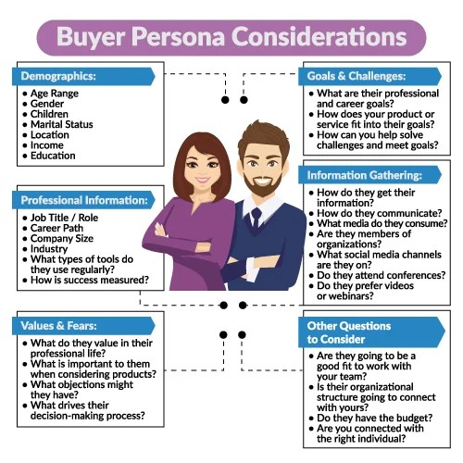
Part 1: Brand study, Competitor Analysis & Buyer’s/Audience’s Persona
Buyer's/Audience's Persona: A buyer persona is a detailed description of someone who represents your target audience. This persona is fictional but based on deep research of your existing or desired audience.

Slide 8
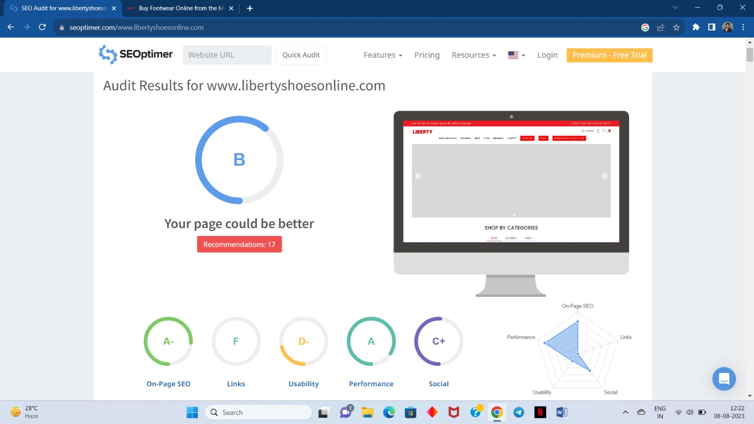
Part 2: SEO & Keyword Research

Slide 9
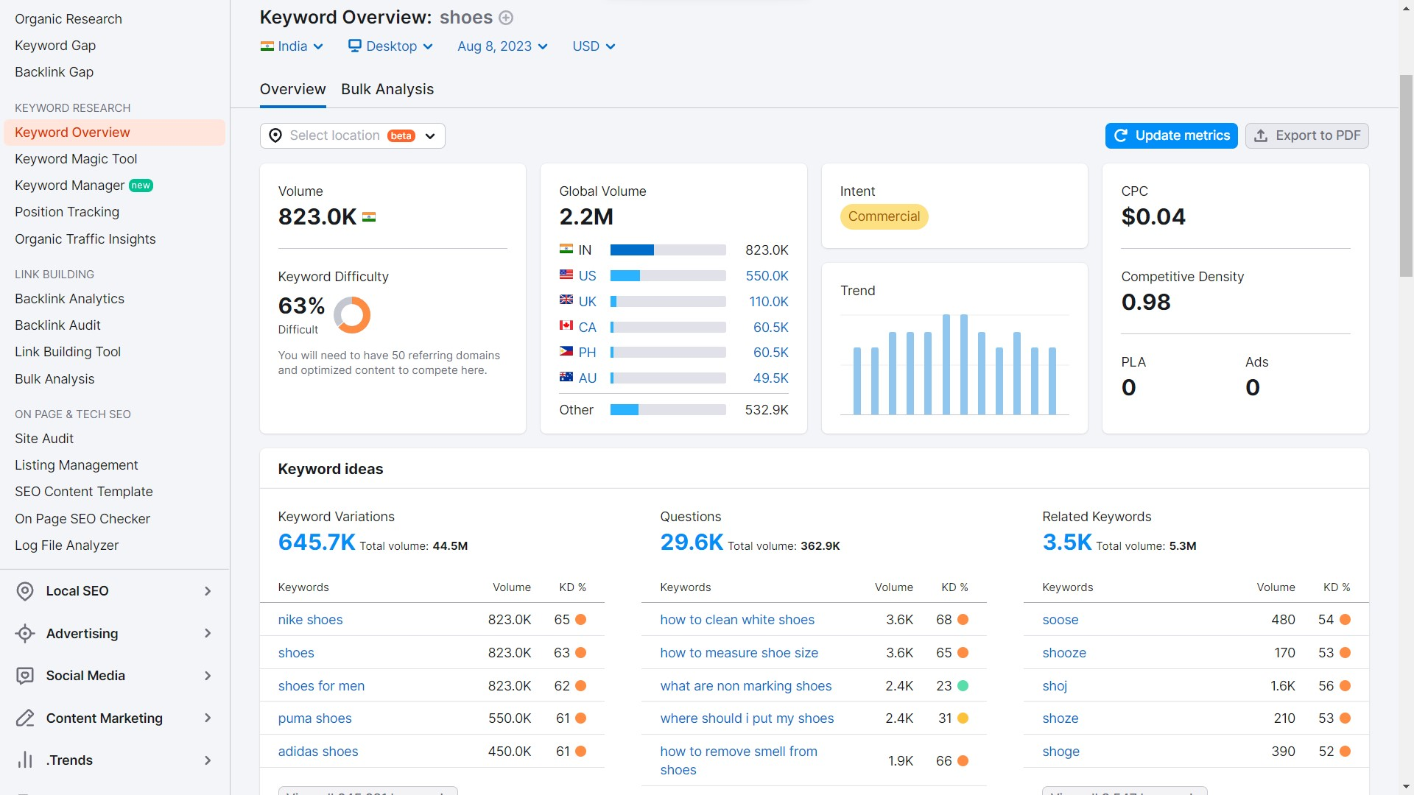
Part 2: SEO & Keyword Research
SEO Title : LIBERTY – Fashion is comfort
Keyword Research:

Slide 10
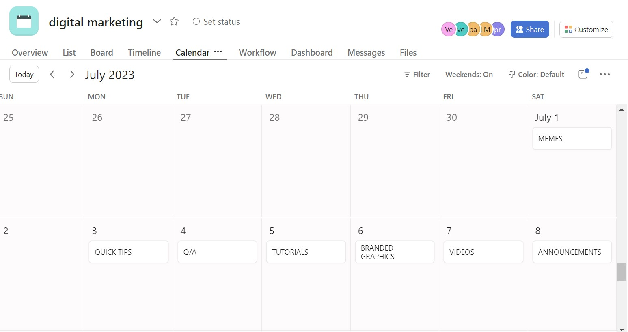
Part 3: Content Ideas and Marketing Strategies content calendar

Slide 11
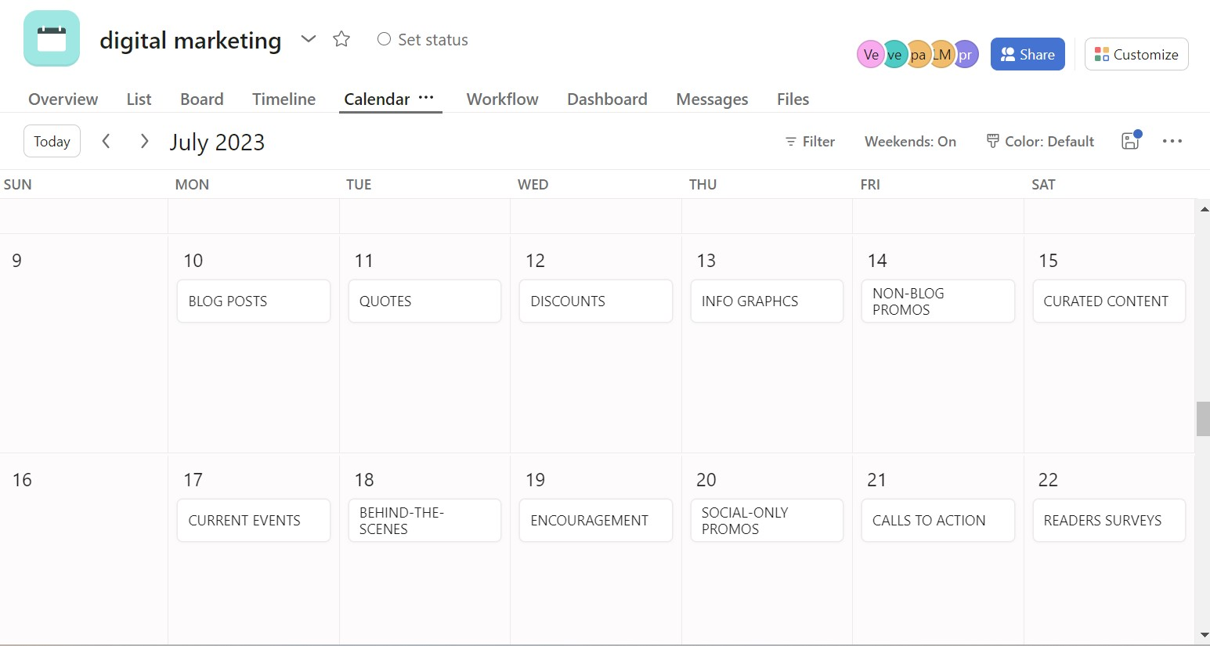
content calendar

Slide 12
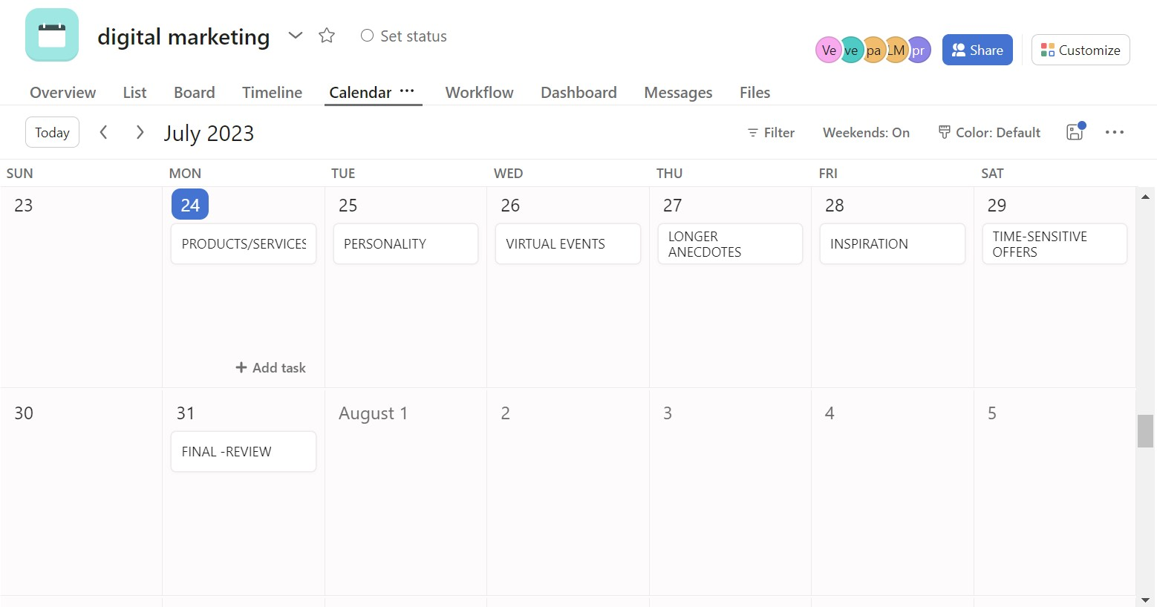
content calendar

Slide 13
Part 3: Content Ideas and Marketing Strategies
Marketing Strategy of Liberty Shoes analyzes the brand with the marketing mix framework which covers the 4Ps (Product, Price, Place, Promotion). These business strategies, based on Liberty Shoes marketing mix, help the brand succeed in the market. Let us start the Liberty Shoes Marketing Strategy & Mix to understand its product, pricing, advertising & distribution strategies:
Quick Glance:
Product Strategy
Pricing Strategy
Place and Distribution Strategy
Promotional and Advertising Strategy

Slide 14
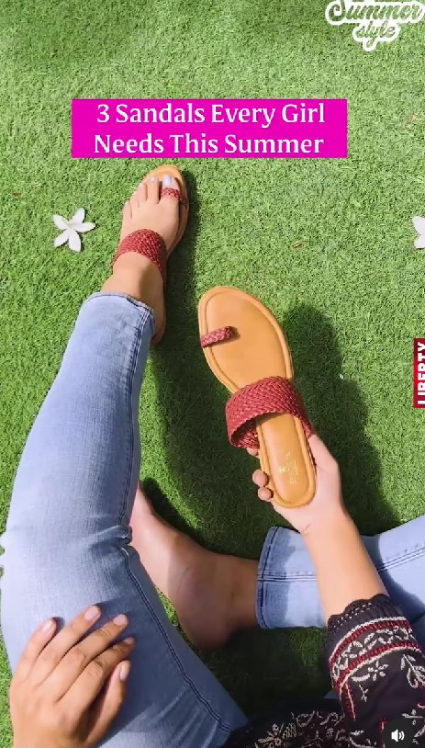
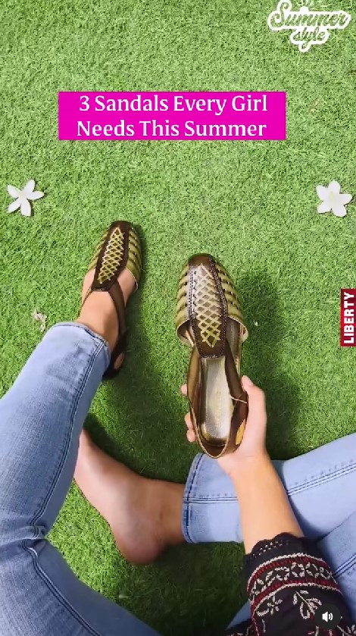

Part 4: Content Creation and Curation
POST CREATION
https://www.instagram.com/reel/CsGMKPyIfju/?utm_source=ig_web_copy_link&igshid=MzRlODBiNWFlZA==

Slide 15
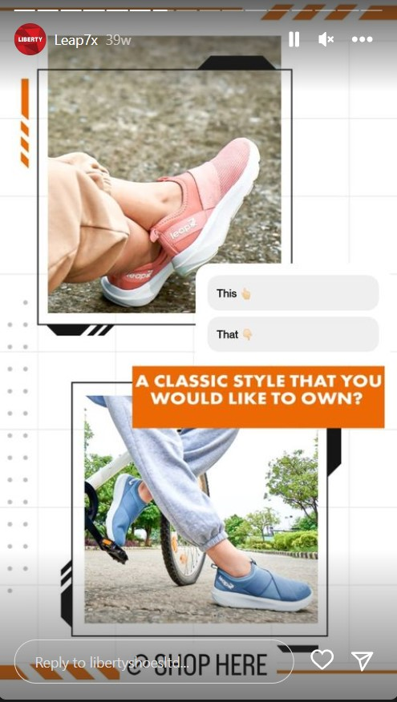
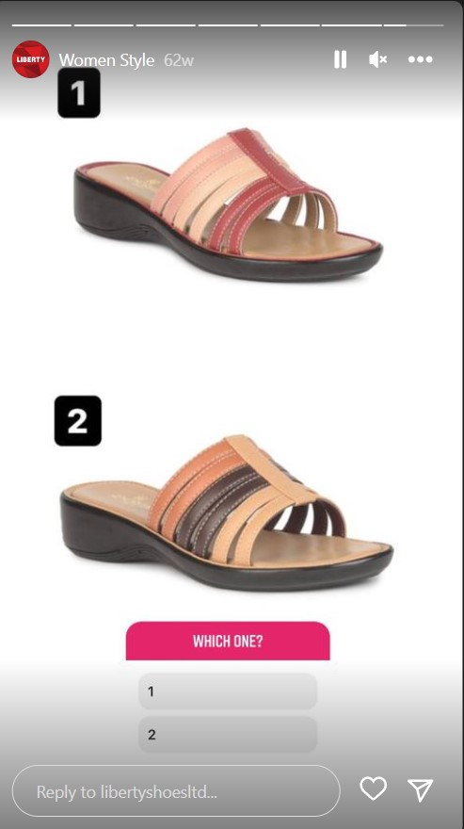
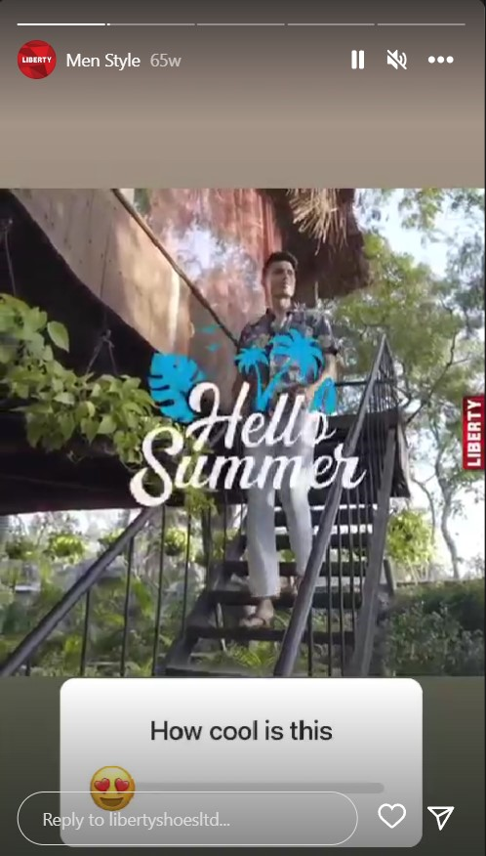
Part 4: Content Creation and Curation
Instagram Story

Slide 16
Part 4: Content Creation and Curation
Designs/Video Editing
Content Creation:Brands are in the constant pursuit of creating engaging content that their viewers would resonate with. However, creating such content calls hours of planning effort, and you need to arrange the resources for the filming and editing.
Video Curation :Video curation is the process of identifying relevant videos on a given subject and collecting them together. You then identify the ones that are the most appropriate and then compile them together. Depending on the nature of the video, you may want to edit them before sharing them with your circle .The major challenge of video curation is devoting long hours to identifying relevant videos and then selecting the very best ones. However, this is simpler than creating original content every day and is an effective way of establishing brand familiarity with your target group.

Slide 17

Part 4: Content Creation and Curation
Designs/Video Editing

Slide 18
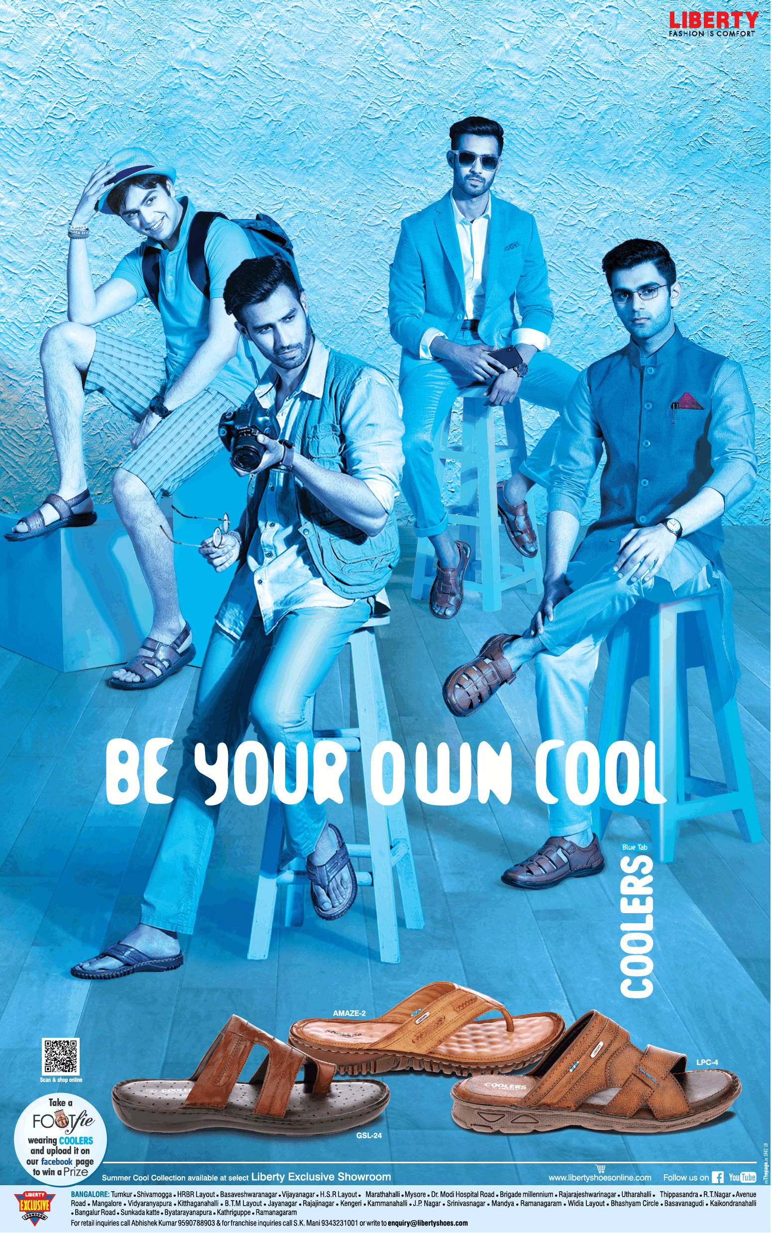
Social Media Ad Campaigns
Part 4: Content Creation and Curation

Slide 19
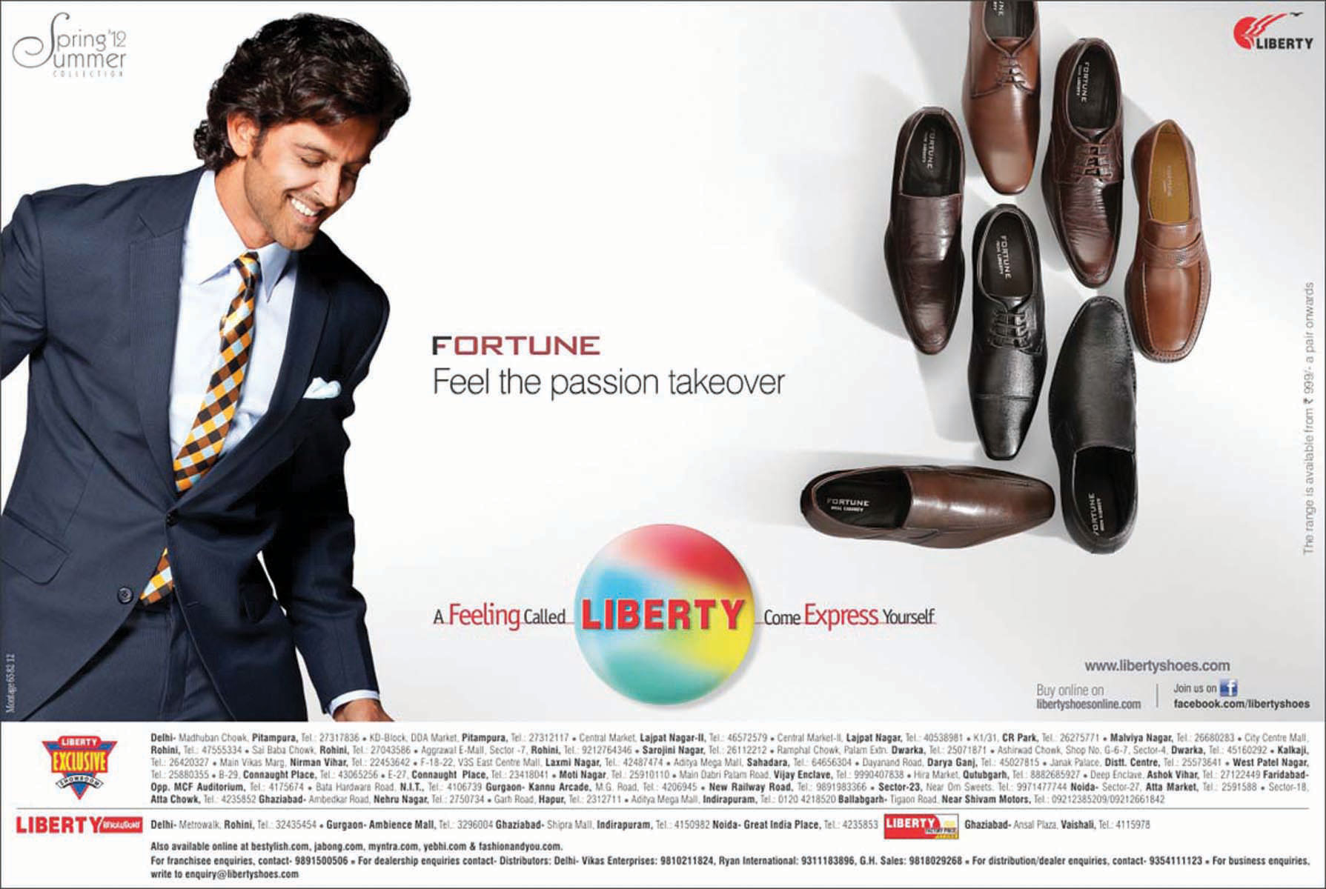
Part 4: Content Creation and Curation
Email Ad Campaigns

Slide 20
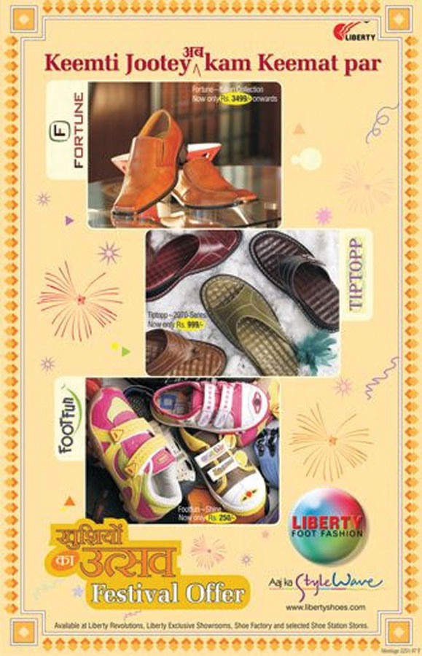
Email Ad Campaign 1 - Brand Awareness

Slide 21

Email Ad Campaign 2 - Lead Generation

Slide 22
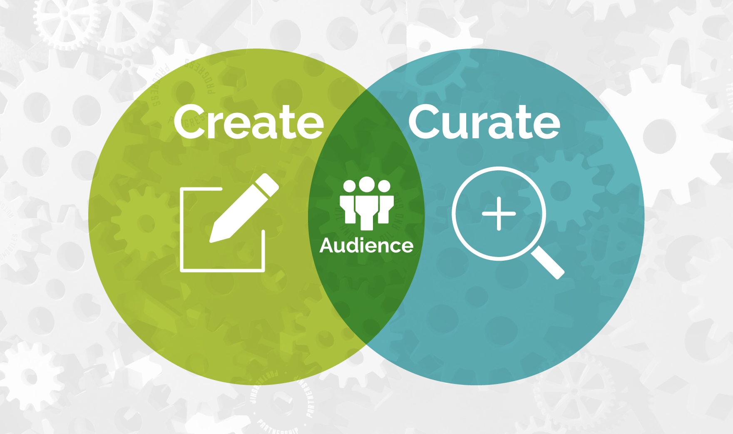
Part 4: Content Creation and Curation

Slide 23
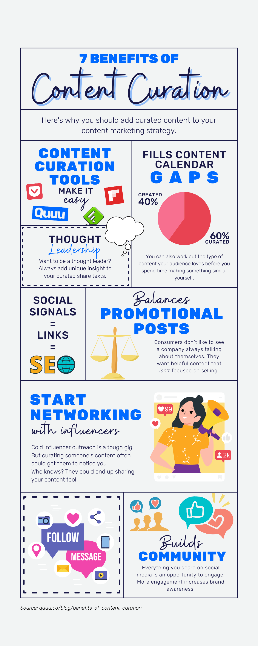
Part 4: Content Creation and Curation
Content curation is the act of finding and sharing excellent, relevant content to your online followers.
With content curation, companies deliver a wide variety of content to their customers, keeping them engaged with well-organized and meaningful material.
In today’s fast-paced and competitive marketplace, content curation is growing increasingly popular as a way of keeping up with growing demands for information and entertainment from customers.

Slide 24
THE END

